Slide 1
Building Modular 3D Human Model using any Game Engine

Slide 2



This month we worked on Unity, Blender and Unreal game engines.
We tried to build 3D human models using the tools available.
In the coming days we will try to focus on appearance, hair style and colour, clothes and skin tones.

Slide 3
Things to be included in creating a model:
Interface
Initial Settings
Primitives
Lighting
Materials and Textures
World Settings
Animation

Slide 4
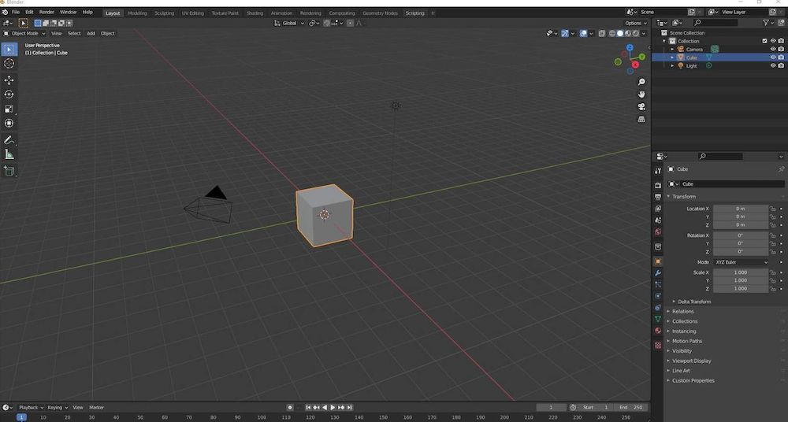
Basic Interface Menus A Cube Camera Light Window Type Settings Layers

Slide 5
Different Views
Can view from the
Front NumPad1
Side NumPad3
Top NumPad7
Camera NumPad 0
Can be in orthographic or perspective mode!
NumPad 5 toggles
Recommendation stay in orthographic!
Can also use the view menu

Slide 6
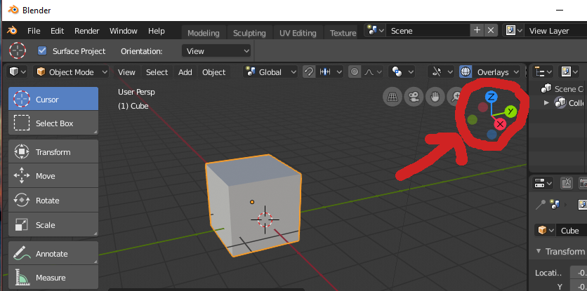
Basic Transformations
Standard Operations
rotate r key
scale s key
grab (translate) g key
skew press s key, then middle mouse drag
Click mouse when finished

Slide 7
Starting Stage Of Human Model:
Start with adding of the cube on to the plane.
By using the Mirror animation we can add the cube on both sides and in object mode.

Slide 8
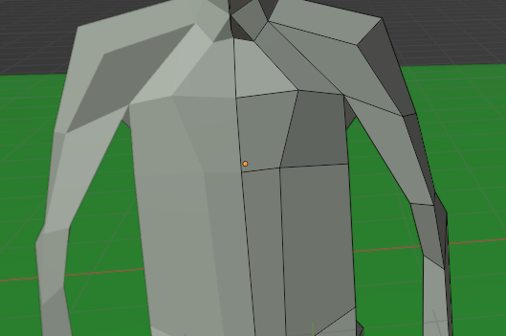
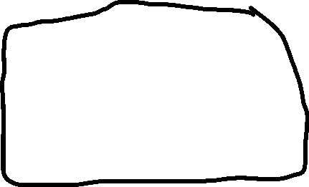
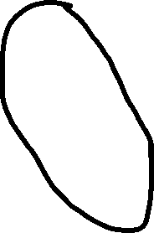
3. By Using the Extrude Function (Shortcut – e) By selecting the edges and vertices we can extend the part however we to.
4. By using the grab, scale and rotate functions we can create the complete body.

Slide 9
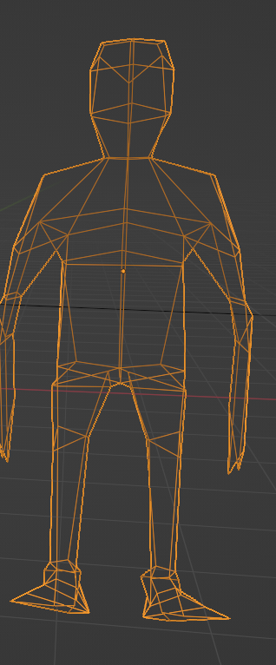
WireFrame Model:
5. We can check the body parts and shape in wireframe model which will be observed while holding the "Z" alphabet.
6. By using Edge Select, Vertex select and Face
Selection we can select multiples edges, faces
And vertices by holding the (Shift+Parts).
7. Using grab and scale we can adjust the body
parts to what extent we want and whatever the shape we want to give to the model.

Slide 10
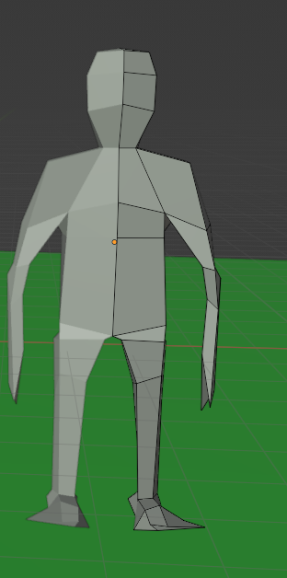
​Solid Model :
Final output in the solid model will be as follows Then after by using the function (Shade Smooth and shade auto smooth) we can soft the body from top to bottom.
By using the UV sphere we can add the eye by adding the modifier for coloring the parts.
(To increase the selection part gradually use – ctrl++)

Slide 11

Work-let Name: Building Modular 3D Human Model using any Game Engine
Worklet Details
Worklet ID: RSG26IIITK
College Name: Indian Institute of Information Technology, Design and Manufacturing, Kurnool
KPIs achieved till now
We explored the software tools and created a base model.
We faced a problem in adjustment of a body parts like stomach, chest.
By using (ctrl + r) we can add a square box wherever we want to and adjust by using the grab function we can solve the issue
Any Challenges/ Issues faced
Understood the working of the software and created a skeleton of the human by using various components.
Next Steps
To work on the following variations:
Appearance, Hair style, colour, Eyebrows, Facial Hair styles,
Skin tones, Clothes.
Key Achievements/ Outcome till now
Date: 08-02-2023

Slide 12
Thank You
Mentors:
D.V.L.N Somayajulu
J. Krishnaiah
Team Members:
M. Deepika
P. Jagadeesh
G. Nagendra

